Slide 1






Digital
Brainstorm
A creative way to encourage everyone
to think and share ideas

Slide 2





Today's Agenda
1
Introduction to the Session
3
Digital Brainstorm
2
Team Check-in and Icebreaker
4
Summary and Action Items

Slide 3

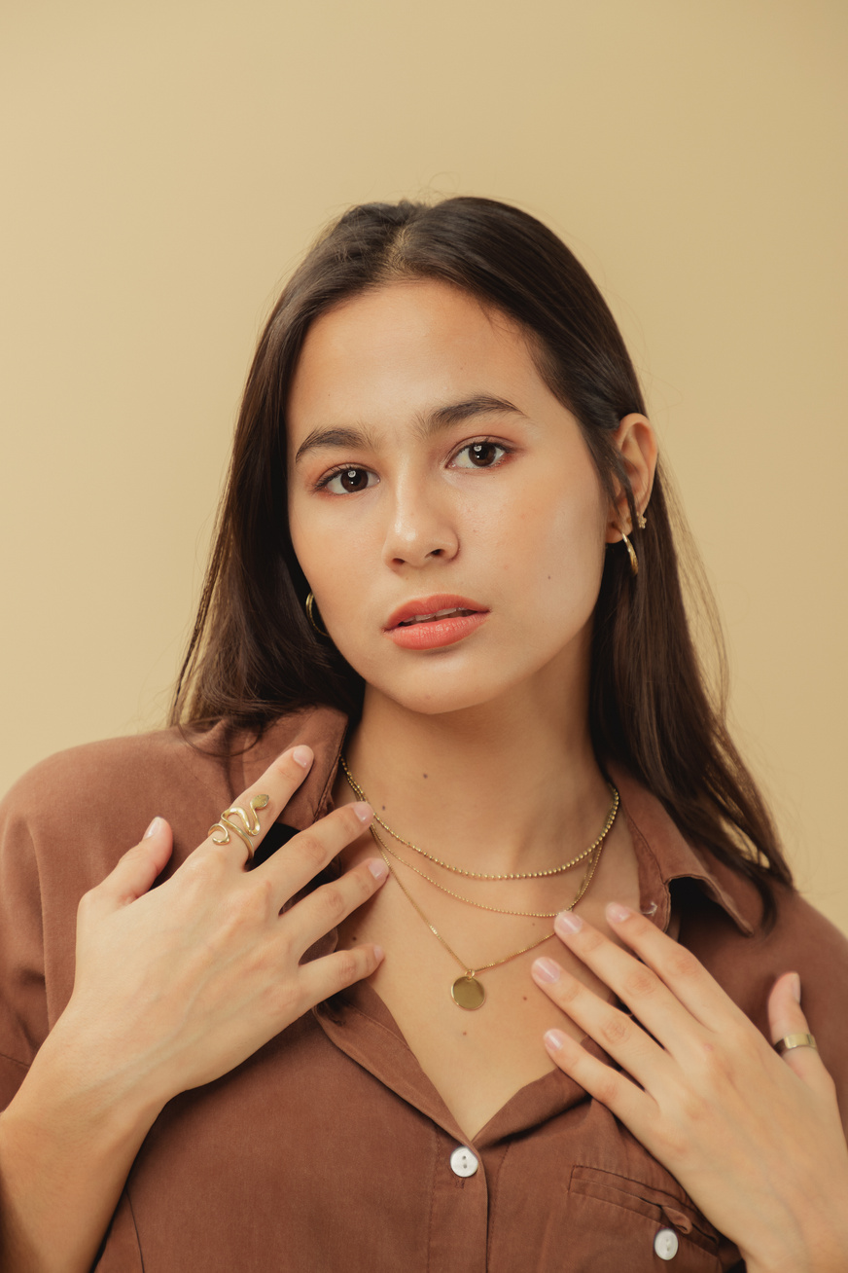




Introduction
Lucy and Chloe will be our facilitators for this session.
Lucy
The goal of our session is to turn chaos into clarity. As facilitators, our role is to keep the session on track and to ensure everyone participates in the discussion.
Chloe

Slide 4







Team Check-in
Click the More tab in the editor side panel
1
Select the Emoji
or GIPHY app
2
How are you feeling?
Browse and click the Emoji or GIF you want to use
3
Choose an Emoji, GIF, or image from a mood meter that best represents how you feel at the moment.

Slide 5






Before we start with the
session, let's warm up a little
with this icebreaker question:
Team Check-in
What was the last thing you purchased online?
1
What did you have for breakfast today?
2
What's your morning routine?
What’s a random act of kindness you did for a stranger?
3
What's the most challenging thing you've done in life?
4
5
What's your favorite dessert?

Slide 6



Get those creative juices flowing!
Let's begin

Slide 7






Copy a sticky note, then we'll write our thoughts, ideas, and inspiration.
Digital
Brainstorm
1
Add your
idea here
Add your
idea here
Starting on a new project begins with a curation of ideas. This digital brainstorm session will allow us to lay down and organize all our thoughts, ideas, and inspiration. Next, we will vote on ideas that are promising and add comments.
Use the stars to vote which ones we like to pursue.
2
Circle or comment on any promising ideas.
3

Slide 8

What's your brainstorm topic?
Brainstorm Area
Our Favorite Ideas
Copy a sticky note, then we'll write our thoughts, ideas, and inspiration.
Use the stars to vote which ones we like to pursue.
Circle or comment on any promising ideas.
1
Add your
idea here
Add your
idea here
2
3

Slide 9



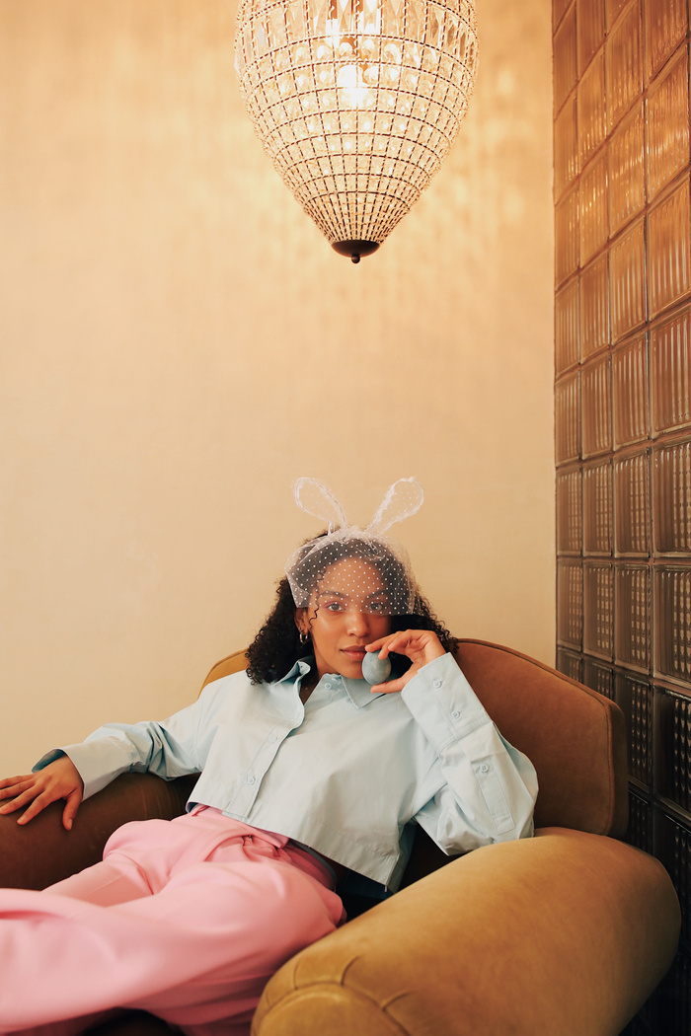

Action Items
1
Write action items in the boxes.
Add your
idea here
Add your
idea here
Add your
idea here
Let's go back to the previous pages and synthesize what next actions are appropriate for us to move forward as a group.
Drag your photo under the
action item you want to own.
2

Slide 10



Action Items
Action 1
Action 2
Write action items
in the boxes.
Add your
idea here
1
Add your
idea here
Add your
idea here
Action 3
Action 4
Drag your photo under the action item you want to own.
2
Add your
idea here

Slide 11



That's a wrap!
Thank you for participating!

